Slide 2
Monday, October 10th, 2022
Unit
3
COMMUNITY SERVICE
LESSON 2: A CLOSER LOOK 1 p.30
Vocabulary
Use words related to community activities
Pronunciation
/t/, /d/, /ɪd/
Unit
HOBBIES

Slide 3
WARM-UP
Match the verbs with the suitable nouns.
recycle | help | plant
trees | vegetables | small children | old people
books | bottles | cans | homeless children

Slide 4
WARM-UP
Match the verbs with the suitable nouns.
recycle
books
bottles
cans
help
small children
homeless children
old people
plant
trees
vegetables

Slide 5
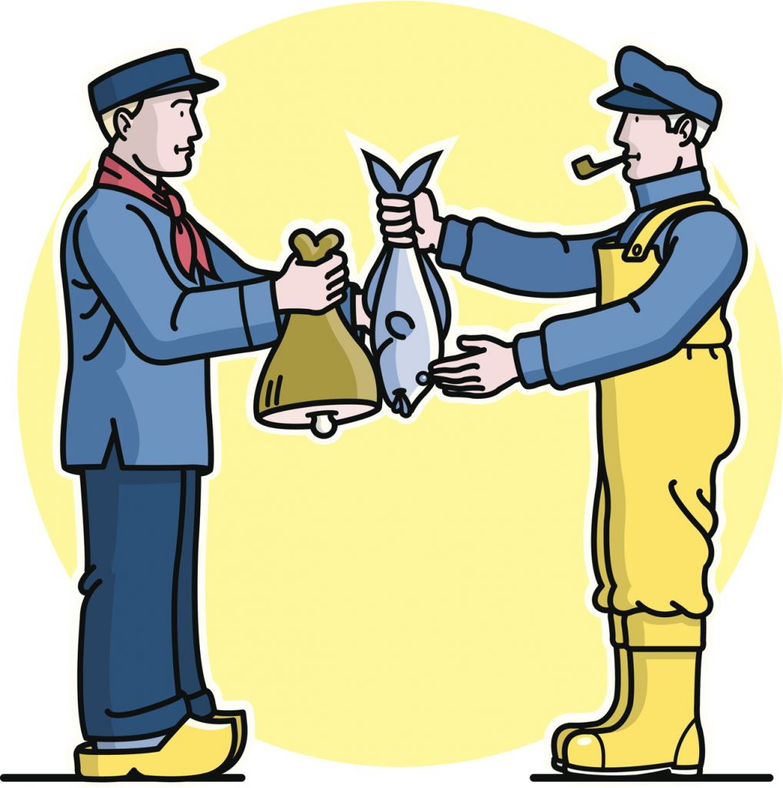
1. VOCABULARY
exchange (v)
/ɪksˈʧeɪnʤ/
trao đổi

Slide 6
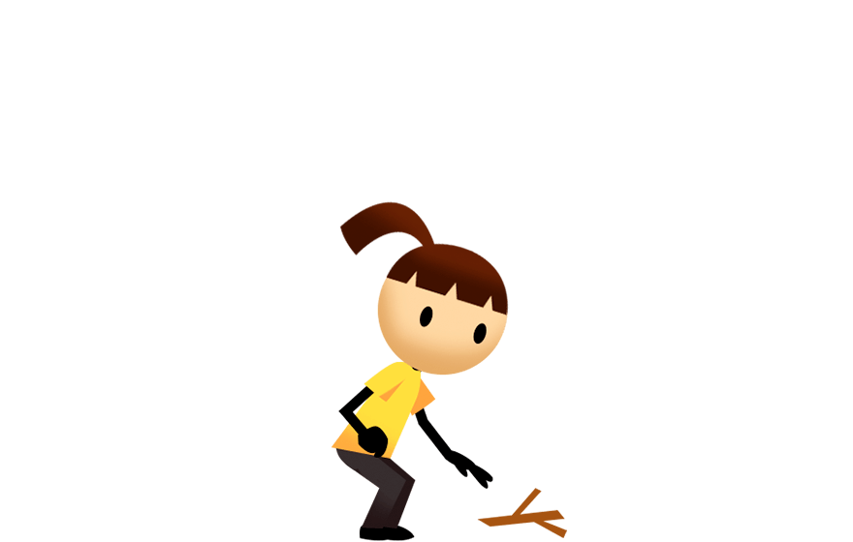
VOCABULARY
pick up (phr. v.)
/pɪk ʌp/
nhặt lên

Slide 7
VOCABULARY
tutor (v)
/ˈtjuːtə/
dạy kèm

Slide 8
VOCABULARY
New words | Pronunciation | Meaning
1. exchange (v) | /ɪksˈʧeɪnʤ/ | trao đổi
2. pick up (phr. v.) | /pɪk ʌp/ | nhặt lên, hái (hoa)
3. tutor (v) | /ˈtjuːtə/ | dạy kèm

Slide 9
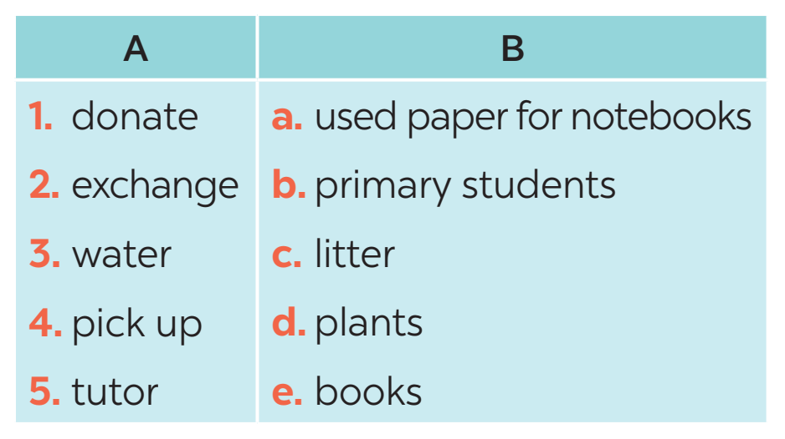
VOCABULARY
1
Match a verb in a with a word or phrase in B.
1. e
2. a
3. d
4. c
5. b
Notes:
Wordwall game: https://wordwall.net/resource/27241481

Slide 10
VOCABULARY
2
Complete each of the sentences with a suitable word or phrase from the box.
tutor litter water donate used paper for notebooks
1. We pick up ____________ at the local park every Sunday. 2. Children in our village exchange ____________________________ every school year. 3. Tom and his friends ____________ the plants in their neighborhood every weekend. 4. We ____________ old textbooks to children in rural areas. 5. Minh and his friends often ____________ small children in their village.
litter
used paper for notebooks
water
donate
tutor

Slide 11
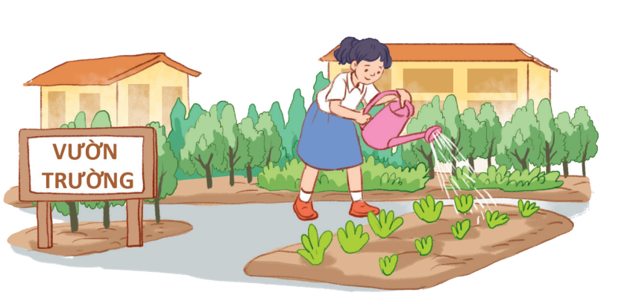
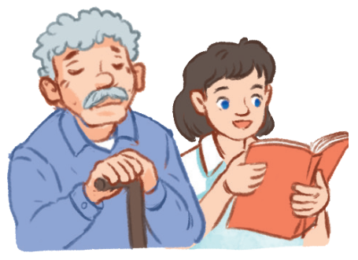
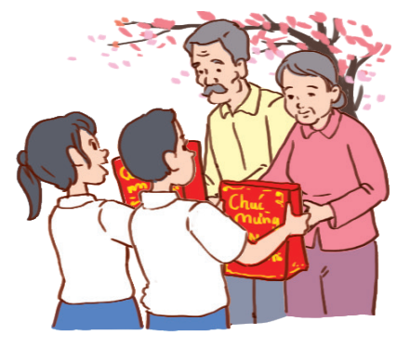
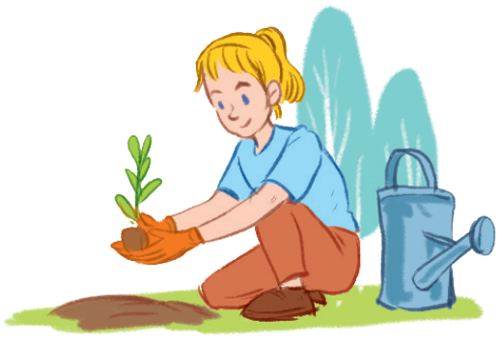
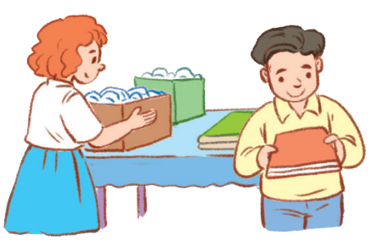
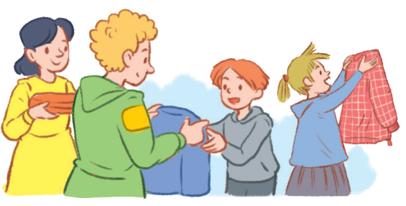
VOCABULARY
3
Use the phrases from the box to write full sentences under the correct pictures.
0. watering vegetables in the school garden
1. giving gifts to old people
2. exchanging used paper for notebooks
3. planting trees in the park
4. reading books to the elderly
5. donating clothes to poor children
1.
2.
3.
4.
5.
1. She’s reading books to the elderly.
2. They’re giving gifts to old people.
Example:
0. Lan is watering vegetables in the school garden.
3. They are exchanging used paper
for notebooks.
4. They’re donating clothes to poor children.
5. She’s planting trees in the park.

Slide 12
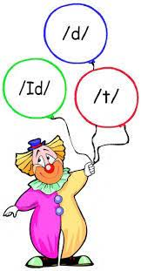
PRONUNCIATION

Slide 13
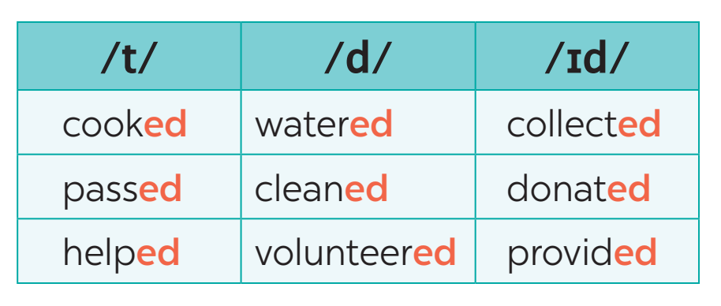
PRONUNCIATION
4
Listen and repeat. Pay attention to the sounds /t/, /d/, and /ɪd/.

Slide 14
PRODUCIATION
5
Listen to the sentences and pay attention to the underlined parts. Tick the appropriate sounds. Practice the sentences.

Slide 15
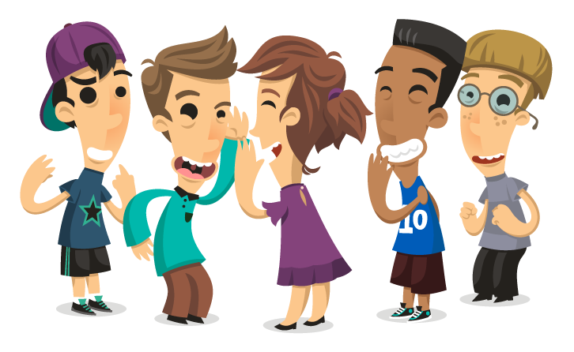
PRODUCIATION
Game: Broken telephone
/t/ | /d/ | /ɪd/
picked, booked, helped | tutored, watered, exchanged | donated, planted

Slide 16
CONSOLIDATION
1
WRAP-UP
Vocabulary
Use words related to community activities
Pronunciation
/t/, /d/, /ɪd/

Slide 17
CONSOLIDATION
2
HOME ASSIGNMENTS
- What can you do to make your neighborhood to be a greener place? Write at least 3 activities.
-Make sentences using the vocabulary

